Slide 1
Title: Amazon Product Review Sentiment Analysis Subtitle: Classifying Customer Feedback Using Lexicon and Machine Learning Models Group: Group 1 Objective: To classify customer product reviews into positive or negative sentiments and compare the performance of a lexicon-based method (Text Blob) against a machine-learning model (Naive Bayes).
Kwagala Ian 2023-B072-20932
Aijuka Josbert 2023-B071-20758
Babirye Stephania 2023-B071-21283
Nakakande Jennifer W.S 2023-B071-22675
Kyoloobi Edwin 2023-B071-22336
Nakanwagi Pamela Maureen 2023-B071-20462

Slide 2
Project Workflow
Objective: Analyze Amazon product reviews to automatically determine if the sentiment is positive or negative.
Dataset: amazon_review.csv containing review text and overall star ratings.
Methodology:
Data Loading & EDA: Understand the dataset's structure and distributions.
Preprocessing: Clean and standardize the review text.
Feature Engineering: Convert text into numerical features using TF-IDF.
Modeling & Comparison:
Machine Learning: Naive Bayes Classifier
Lexicon-Based: TextBlob Polarity Analysis
Evaluation & Interpretation: Compare model accuracy, analyze key features, and draw conclusions.

Slide 3
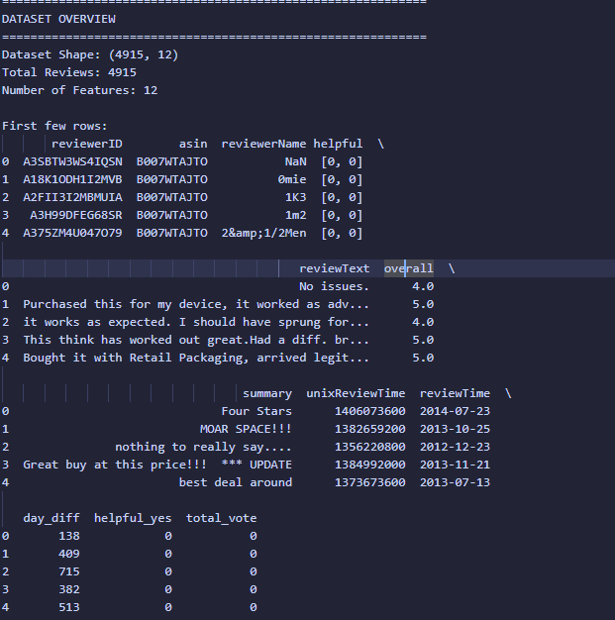
Data Acquisition & Initial Exploration
Dataset Overview:
Loaded amazon_review.csv containing 4,916 reviews.
Key columns: reviewText (the review itself) and overall (star rating from 1-5).
Only two reviews had missing text and were removed.

Slide 4
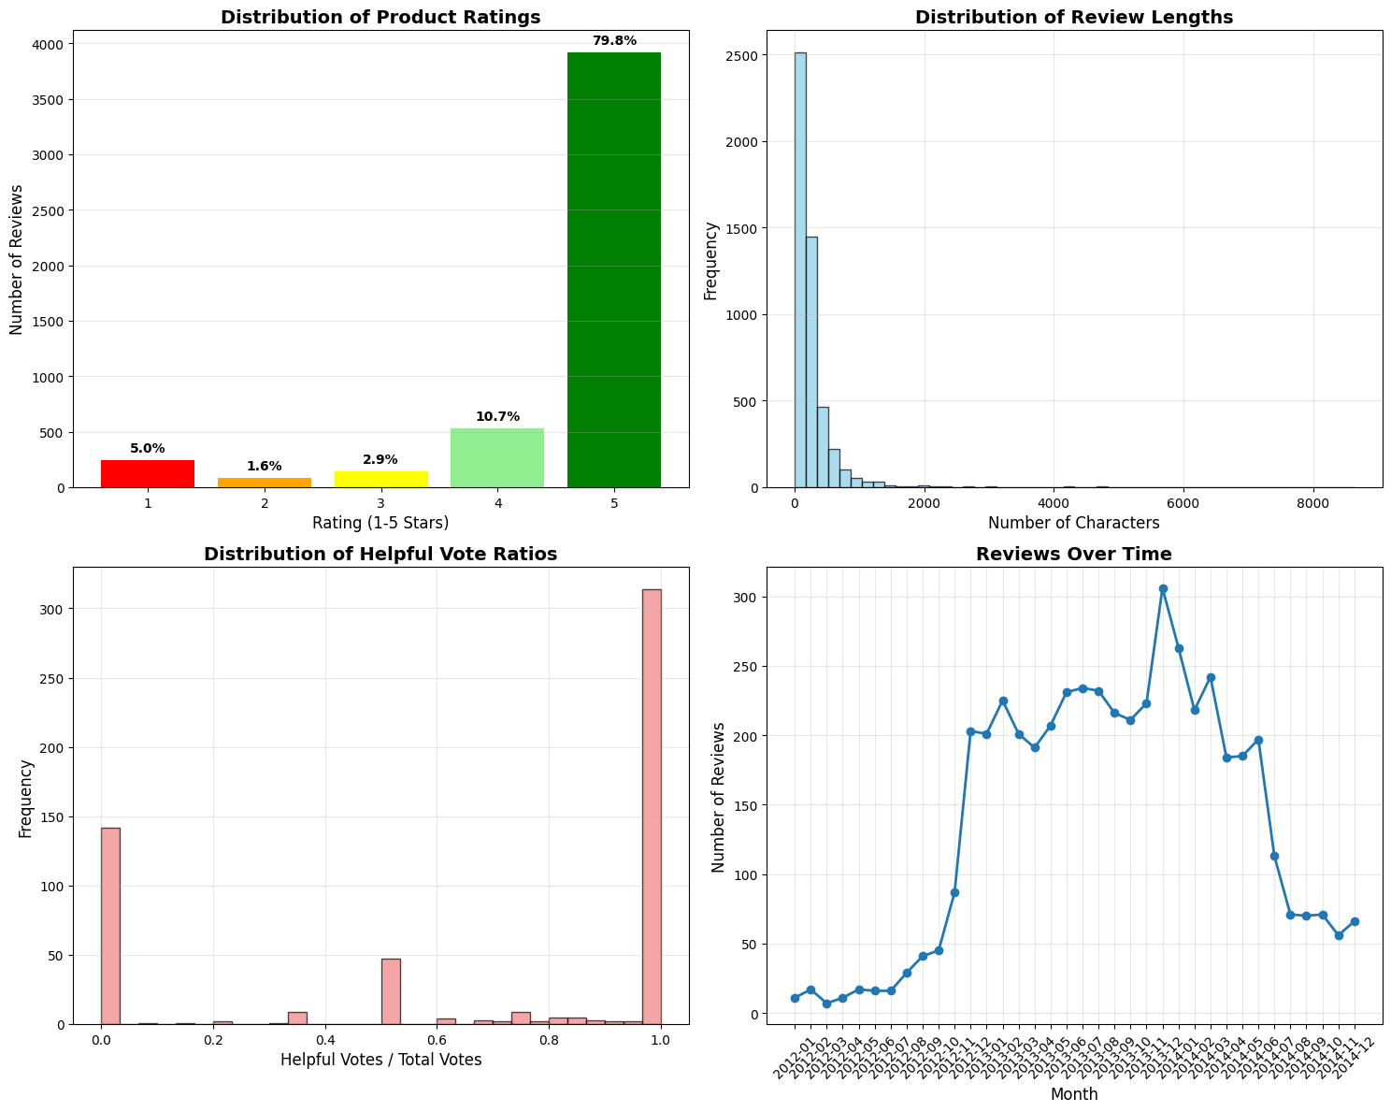
Exploratory Data Analysis (EDA)
Key Insights:
Rating Distribution: The dataset is heavily skewed towards positive reviews, with 79.8% of all ratings being
5-star.
Review Length: Most reviews are short (median length of 172 characters), but some are very long, indicating
a wide range of detail.
Helpfulness: Many reviews have no votes, but for those that do, a high ratio of "helpful" votes is common.
Temporal Trend: The number of reviews shows fluctuations over time, peaking around early 2014.

Slide 5
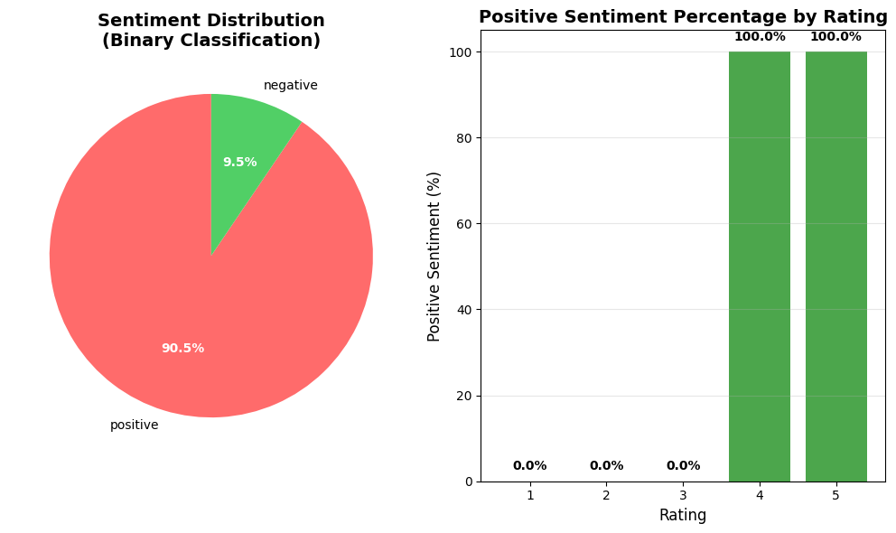
Defining Sentiment: From Ratings to Labels
Method: We converted the 1-5 star ratings into binary sentiment labels to frame the classification problem.
Positive Sentiment: Ratings of 4 or 5 stars.
Negative Sentiment: Ratings of 1, 2, or 3 stars.
Resulting Distribution:
This confirms a significant class imbalance, with positive reviews vastly outnumbering negative ones
(90.5% vs. 9.5%). This can pose a challenge for the machine learning model.

Slide 6
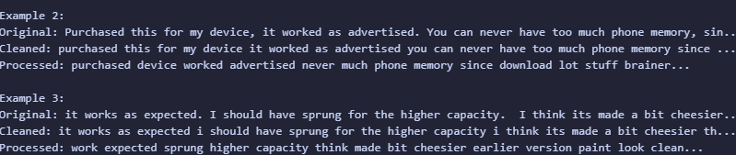
Text Preprocessing Pipeline
Goal: To clean and normalize the raw review text for effective feature extraction.
Steps:
Cleaning: Converted text to lowercase, removed URLs, HTML tags, and all non-alphabetic characters.
Tokenization: Split text into individual words.
Stop word Removal: Removed common English words (e.g., "the", "a", "is") that don't carry sentiment.
Lemmatization: Reduced words to their base or dictionary form (e.g., "worked" -> "work").
Example (from Cell 5 output):

Slide 7
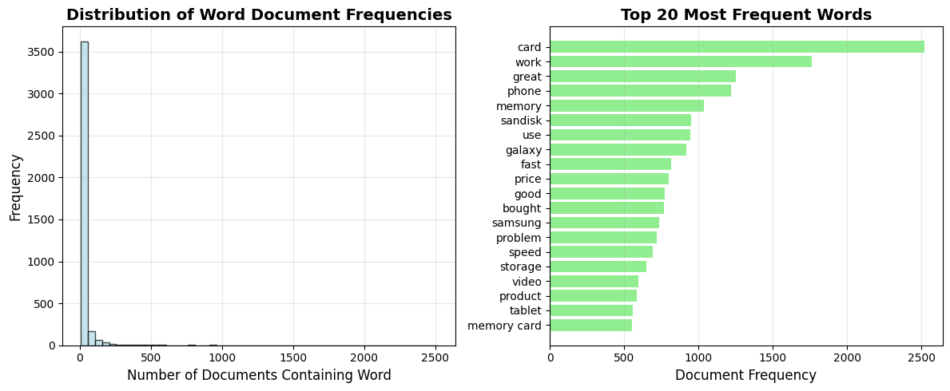
Feature Engineering: TF-IDF
What is TF-IDF?
Term Frequency-Inverse Document Frequency is a technique to convert text into a matrix of numbers.
It measures how important a word is to a document in a collection of documents.
Words that are frequent in one review but rare across all reviews get a higher score.
Implementation:
Created a TF-IDF matrix with 3,950 unique features (words and two-word phrases).
The most frequent words identified include "card," "work," and "great."
Visualization (from Cell 6 output):

Slide 8
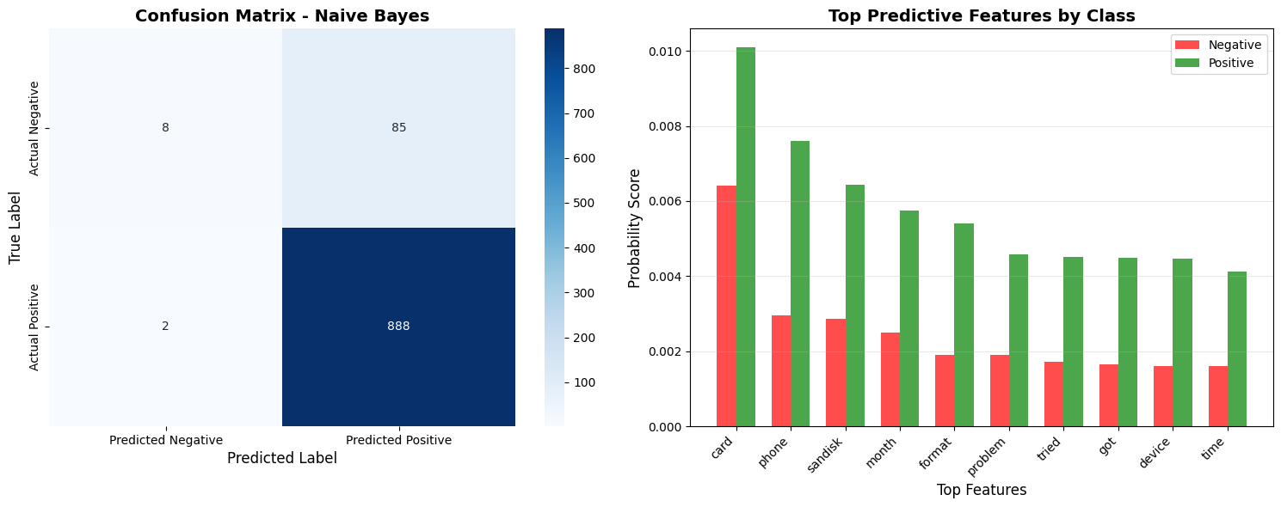
Approach 1: Machine Learning - Naive Bayes
Model: A Multinomial Naive Bayes classifier was trained on the TF-IDF features. This model is well-suited for
text classification tasks.
Performance:
Accuracy: 91.15%
The model is excellent at identifying positive reviews (100% recall).
However, it struggles with negative reviews, only correctly identifying 9% of them (low recall for the
minority class), likely due to the class imbalance.
Results (from Cell 8 output):

Slide 9
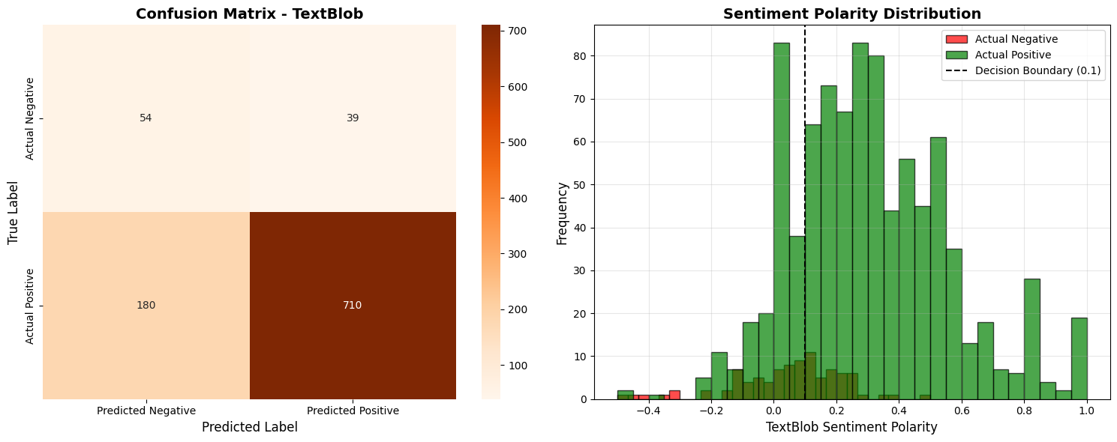
Approach 2: Lexicon-Based - TextBlob
Method: TextBlob uses a pre-built dictionary of words with associated sentiment scores (polarity).
It does not require training.
We classified reviews as "positive" if their polarity score was ≥ 0.1.
Performance:
Accuracy: 77.72%
While less accurate overall, TextBlob was significantly better at identifying negative reviews (58% recall)
compared to the unbalanced Naive Bayes model.
Its weakness is in correctly classifying positive reviews, where it had a lower recall (80%).
Results (from Cell 9 output): (Insert the Confusion Matrix for TextBlob from Cell 9 here)

Slide 10
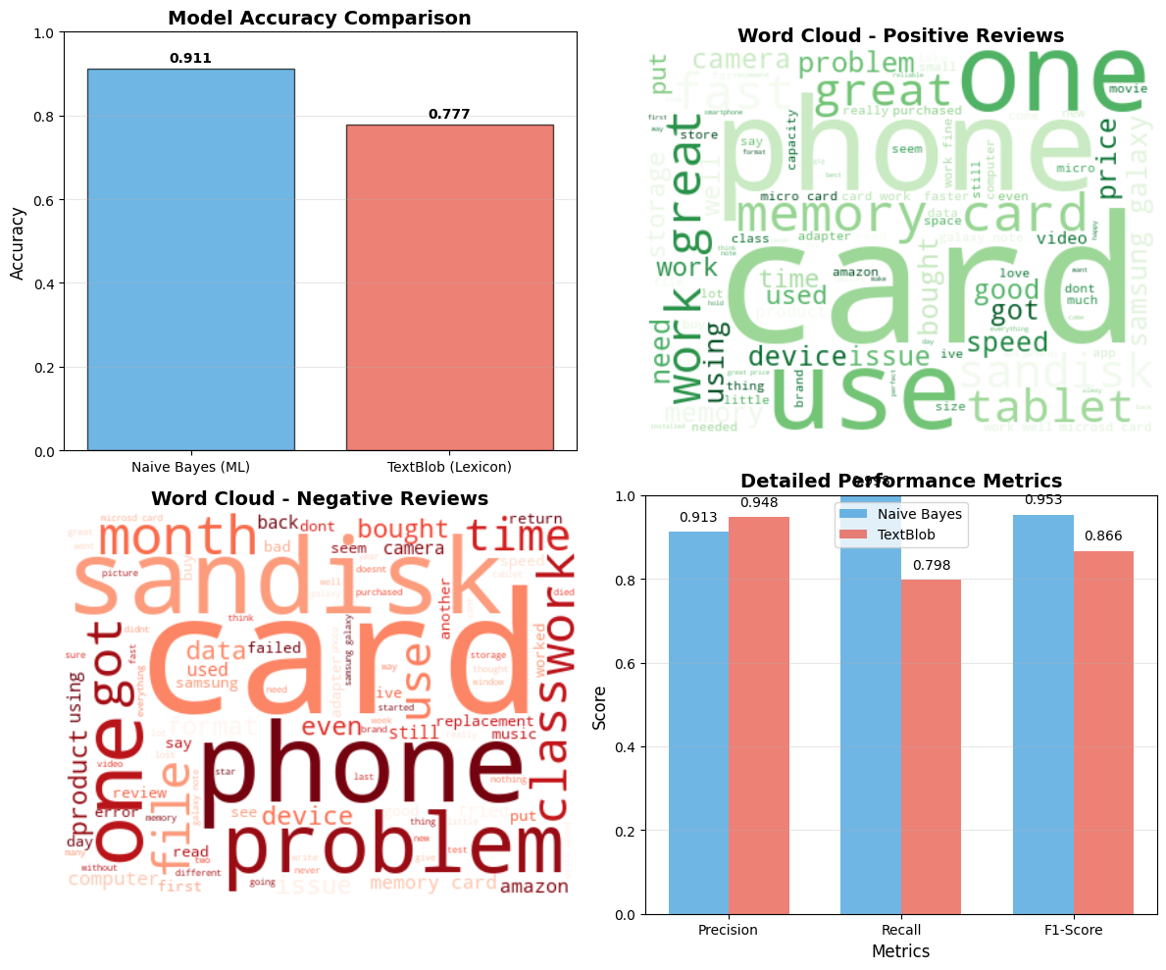
Model Performance Comparison
Conclusion: The Naive Bayes (ML) model performed better in terms of overall accuracy by over
13 percentage points.
Trade-off:
Naive Bayes: Higher precision and accuracy, but misses most negative reviews.
TextBlob: Lower accuracy, but better at "catching" negative reviews.
Visualizations (from Cell 10 output):

Slide 11
What Words Influence Sentiment?
Analysis: We generated word clouds from the processed text to visualize the most prominent words in positive and negative reviews.
Positive Keywords: "great," "work," "fast," "good," "price," and "easy."
Negative Keywords: "card," "phone," "work," "problem," and "sandisk" (note: some words like "card" and "work" appear in both but are used in different contexts).
Word Clouds (from Cell 10 output): (SAME AS ABOVE DIAGRAM USED)

Slide 12
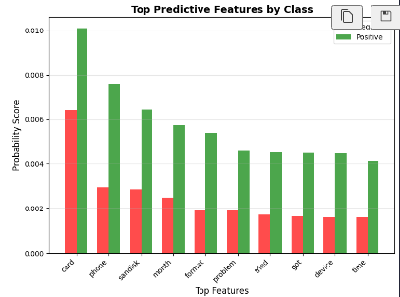
Top Predictive Features (Naive Bayes)
Deeper Dive: The Naive Bayes model allows us to see which words it found most predictive for each class.
Top Positive Words: ['card', 'work', 'great', 'phone', 'memory', 'good', 'use', 'price', 'fast', 'sandisk']
Top Negative Words: ['card', 'phone', 'sandisk', 'month', 'format', 'problem', 'tried', 'got', 'device', 'time']
Insight: Words like "problem," "tried," and "format" are strong indicators of a negative experience, while "great," "good," and "fast" are clear positive signals.
Visualization (from Cell 8 output): (Insert the "Top Predictive Features by Class" bar chart from Cell 8 here)

Slide 13
Final Interpretation & Conclusion
Which model is better?
For overall accuracy, the Naive Bayes classifier is superior (91.2%). The machine learning approach successfully learns patterns specific to this dataset, outperforming the generic lexicon model (TextBlob at 77.7%).
Key Challenges:
The dataset's severe class imbalance is the biggest limitation. Our Naive Bayes model is biased towards the majority (positive) class, leading to poor performance in identifying negative reviews.
Lexicon-based methods like TextBlob struggle with context, sarcasm, and domain-specific language (e.g., "cheesier" build quality).
Business Impact:
An accurate ML model can automate the process of sifting through thousands of reviews.
If the goal is to identify all negative reviews for customer support, the model would need to be tuned to improve recall for the negative class, even at the cost of some accuracy.

Slide 14
Recommendations & Future Work
To Improve the Model:
Address Class Imbalance: Use techniques like SMOTE (to create synthetic negative reviews) or apply class weights in the model to penalize it more for misclassifying the minority class.
Try Advanced Models: Experiment with models like SVM, Logistic Regression, or deep learning models (e.g., LSTMs, Transformers) which can capture more complex language patterns.
Enhance Feature Engineering: Use more advanced features like word embeddings (Word2Vec, GloVe) that understand the semantic meaning of words.
Create an Ensemble: Combine the predictions from both Naive Bayes and TextBlob to potentially leverage the strengths of both approaches.

